Slide 1
State Survey Readiness
Mindy Bundy, RN Administrator 4/9/2025

Slide 2
PRIOR TO SURVEY
Administrator/Nursing Supervisor –
Emergency Preparedness, QAPI including grievances, updated policies, missed visits/overage orders
QA RN/Nursing Manager –
POC tracker, outstanding orders, outstanding assessments, QA Skilled Nursing Charts, RN first contact dates, Audits
RNCM –
Home binder, infection control including bag barrier, IR’s up to date and on logs
Branch Manager –
License on the wall, Evacuation Routes, Emergency Prep uploaded, Authorized Services Tracking report to Clinical Assistants weekly
Recruiting Specialist –
PFs, including TBs, licensing, dementia/in-services, name badges
Care Supervisor –
schedule matches the POC. Notes on unfilled shifts.
HHA –
infection control, following the service plan, following the schedule, knowing policies and who is the Administrator.
Federal recertification and State relicenseure survey of provider
Each agency must be surveyed not later than 36 months after the last day of the previous standard survey.
Usually a 6-month window – can be no later than 10/7/25
Last survey’s deficiencies: N0462 (employee physical), N0464 (TB), G0710 (POC – missed visits), N999 (background check)
Competency has come up A LOT in recent surveys.
Clinical Policies

Slide 3
Survey Arrival
Evansville License Parent branch - Evansville Additional branch on license - New Albany
Breathe and Remain Calm ☺
Greet them and ask for identification. Then ask what service line they are there to survey.
Home Health-HHA-PA-Skilled
Home Care-FSSA-PSA-Waiver-attendant care, homemaker
DD-FSSA
Notify Administrator right away: Mindy - 812-797-6338 Ann - 574-276-0937
Notify Ellee if she is not in the office.
Notify Taylor that surveyors are at the parent branch.
Quick tour of the facility (bathroom and copier).
Have them go to the conference room/ empty room with table/chairs to set up. Somewhere with privacy. *Remove any HIPPA information from room.
Until Administrator arrives, assign one staff member to be resource for surveyor.

Slide 4
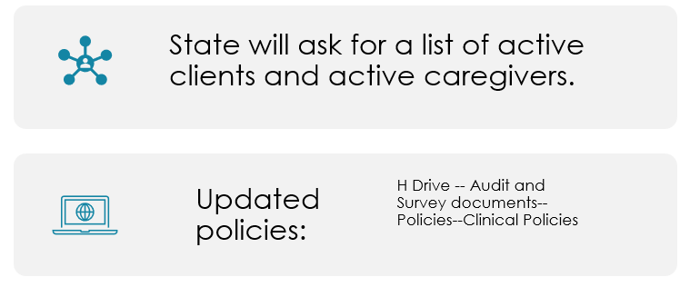
NEXT STEPS
When surveyor is settled, set up call with Mindy and Surveyor for Entrance Call.
They will need a computer with Matrixcare access.
Day 1 - Someone will likely have to give up their computer to the surveyors. They must be logged out of all systems prior to giving their laptop to state. *Contact Amber Armuth for a username and password for them.
They will give us an Agency Survey Report (forms) – Branch Manager can begin filling in.
Ensure the current
Evansville HHA License
is hanging on the wall at Evansville and New Albany both.
Evacuation route maps have been posted in each work area.
The following information is marked on evacuation maps:
Emergency Exits
Fire alarm pull stations’ locations
Locations of fire extinguishers
Primary and secondary evacuation routes
Site Personnel should know at least two evacuation routes.
All staff – Internal and External need name badges worn.
Please keep list of all items given to the surveyors or let Mindy review items first, please.
How to Run Reports to Provide Auditors

Slide 5
They will give you a state survey sign to hang on door. Scan this to all offices on the license. Notify internal staff not present, that a surveyor is present in the office. Notify external staff that state may be calling. Have them please answer the calls and answer any questions honestly. If they are not sure of an answer, they can say, they are unsure but knows how to find out that answer.
Ensure all staff know who these people are and what they do:
Mindy Bundy
Administrator - Directs Day to Day operations of the license.
Nursing Supervisor - Manages, supervises, coordinates, evaluates, develops client care teams to ensure quality care delivery and appropriate case management
Ann Naylor
Alternate Administrator and Alternate Nursing Supervisor – in absence of Mindy
Governing Body
assumes full legal authority and responsibility for the agency’s overall management and operation, the provision of all home health services, fiscal operations, review of the agency’s budget and its operational plans, and its quality assessment and performance improvement program.
James Quach
Shelby Kuhn
Amber Armuth
Kristie Cable

Slide 6
VISITS
Focus will be on visits. Ensure them we will contact the clients for them to get those set up as we need client approval.
They typically want HHA visits as well as SN visits.
Be sure the home binders are up to date: Most up to date admission book, POC, signed med list, etc.
We typically have a RNCM attend the visit to be the eyes and ears in case anything is questioned. They do not participate in the visits itself or need to do anything. No coaching the HHA is allowed. But this also might make the HHA feel more relaxed if familiar face is there for support.

Slide 7
Questions/Concerns

